Slide 1
SALUD-ARTE: Art of Healing
Community Presentations Fall 2020
Women’s & Children’s Hospital

Slide 2
Introduction & Welcome Women’s and Children’s Hospital

Slide 3
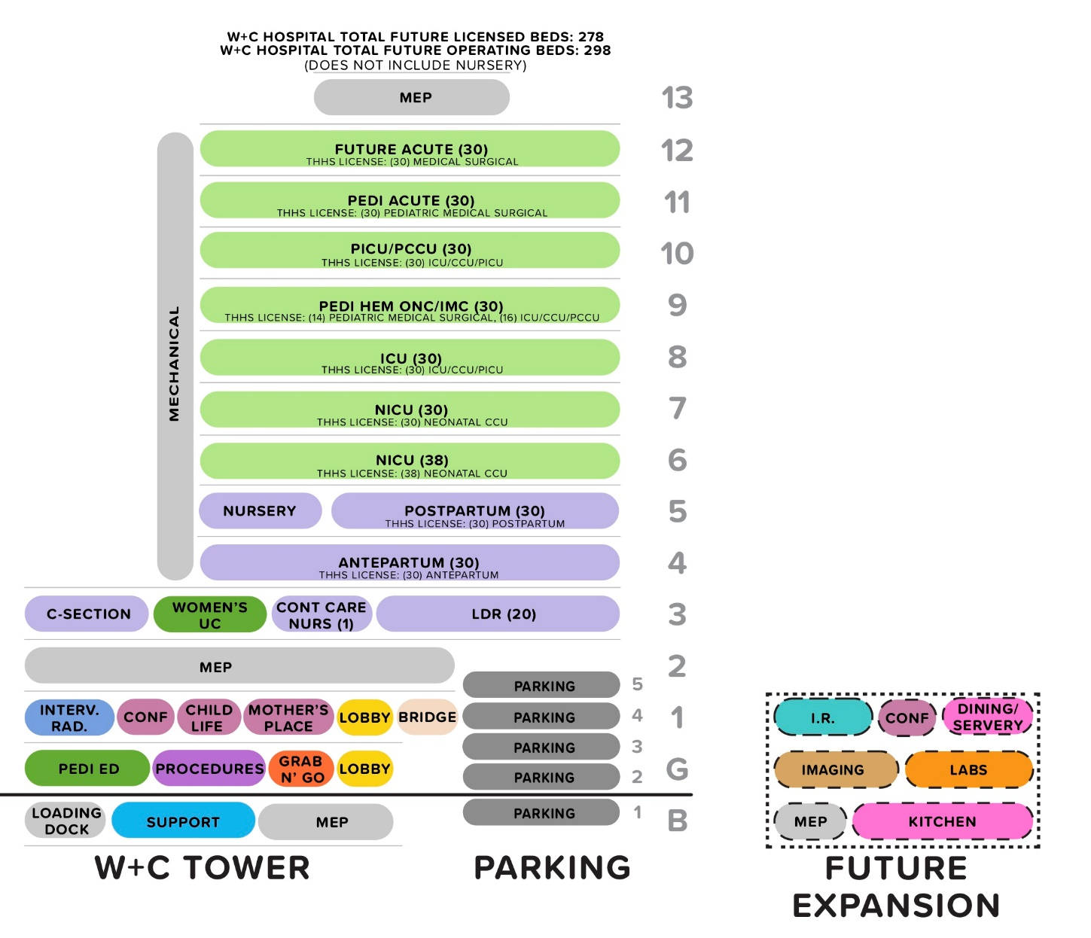
Women’s and Children’s Hospital

Slide 4
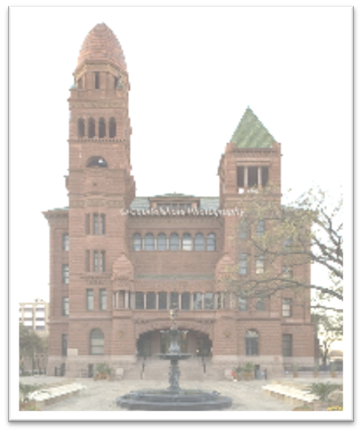
Community Relations Who We Are:
A separate political subdivision of the State of Texas owned by the people of Bexar County
About 9,000 employees. 1,000 physicians. 700 resident physicians
Health System budget for 2020: $1.82 billion
Bexar County Commissioners Court
Appoints Bexar County Hospital District Board of Managers
Sets the annual Hospital District tax rate
Approves the annual capital and operations budgets
Less than 22% of revenue comes from local property taxes.

Slide 5
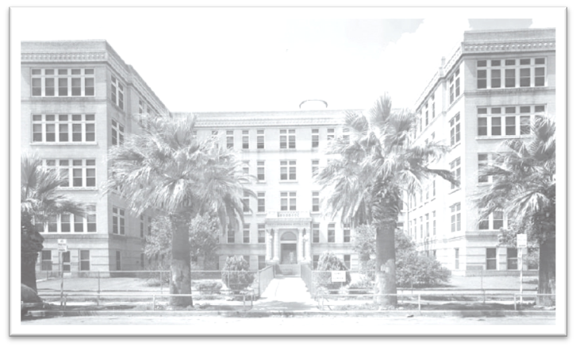
A Tradition of Leadership
Our roots date back to 1917 with the opening of the Robert B. Green Memorial Hospital
The Bexar County Hospital District was established by local voters in 1955
We have been the primary teaching partner of UT Health Science Center School of Medicine since 1968
We are South Texas’ first Nurse Magnet health system (2010 & 2015)

Slide 6
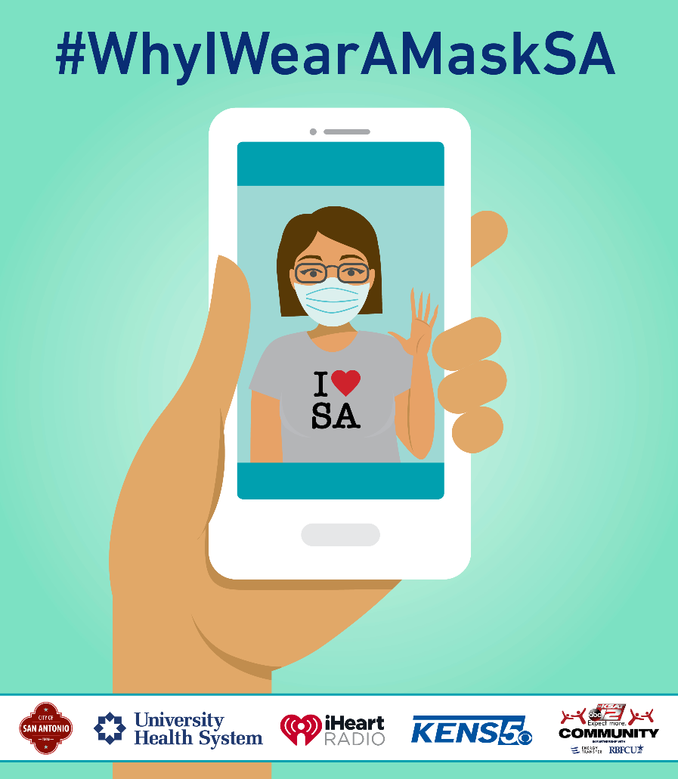
University Health System has been on the forefront of our community’s response to the COVID-19 pandemic.
Stood up the first drive-thru COVID-19 testing for healthcare workers.
Coordinated hundreds of news stories, and activated social media to be a trusted source of reliable information. Including #WhyIWearAMaskSA campaign.
Held multiple blood drives to ensure adequate supplies during the lock-down.
Questions? Anita Uribe Martin, Director, Community Outreach: anita.martin@uhs-sa.com

Slide 7
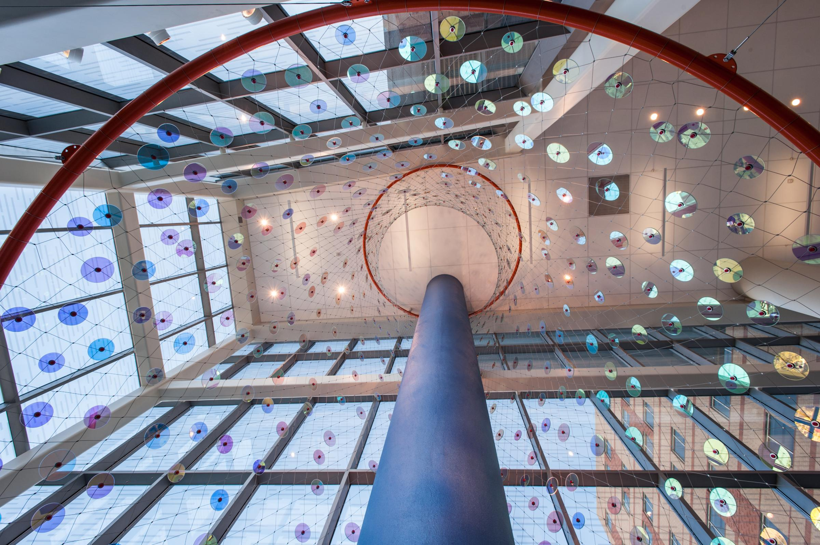
Salud-Arte: Mission Statement
“Our vision is to use art to inspire healing, compassion, hope and trust. We also aim to reflect the community, improve the experience of our patients and visitors, and communicate our important mission through art and design enhancements, while being good stewards of our financial and natural resources.”
University Health System
Design Enhancement Public Art Committee, 2010
Ed Carpenter, Foxglove

Slide 8
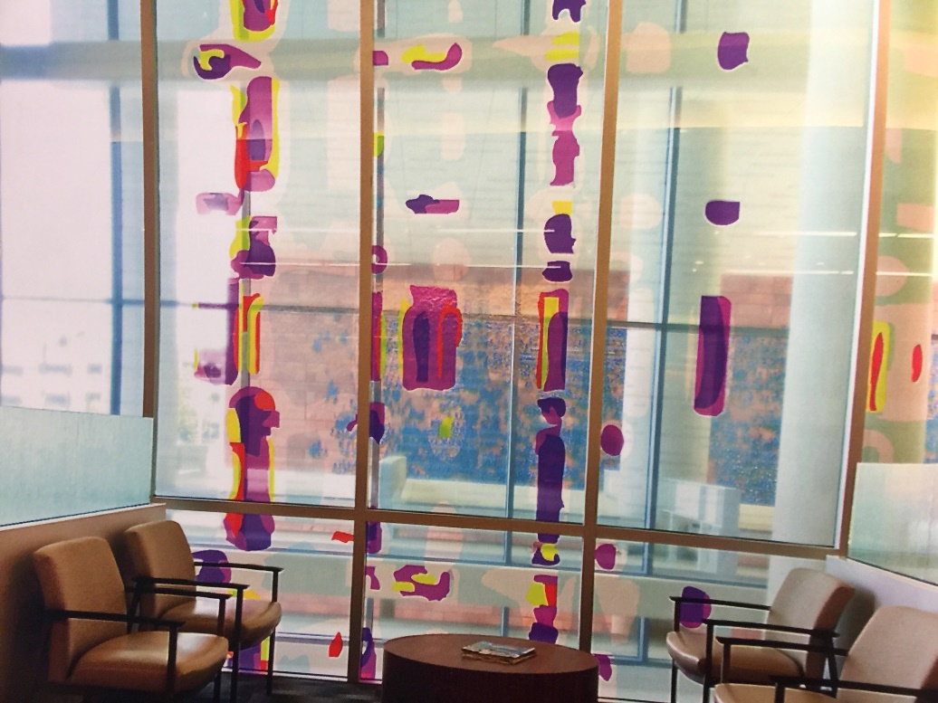
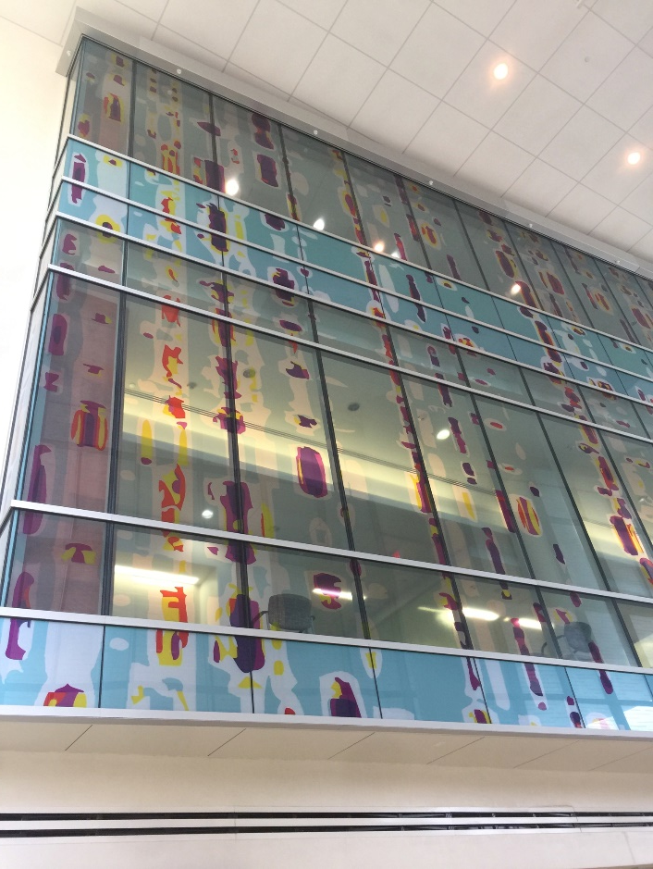
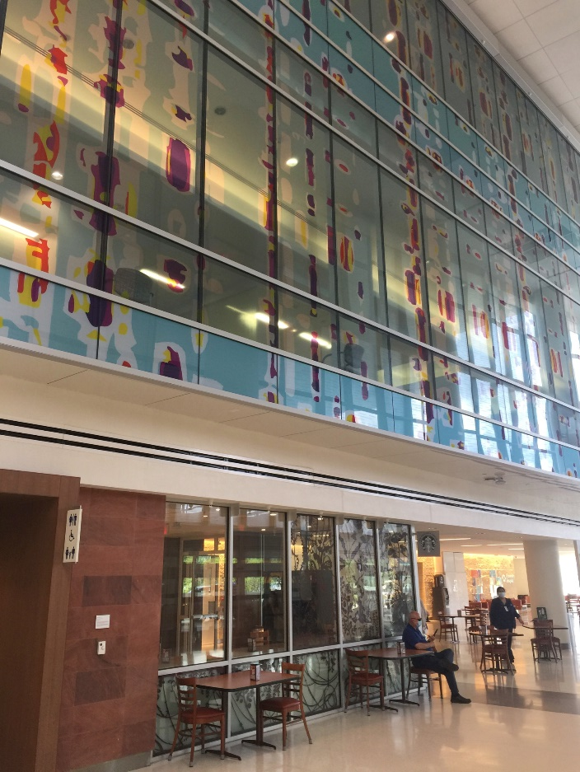
Design Enhancement
DNA Curtain Wall
Design by artist Angel Rodriguez-Diaz

Slide 9
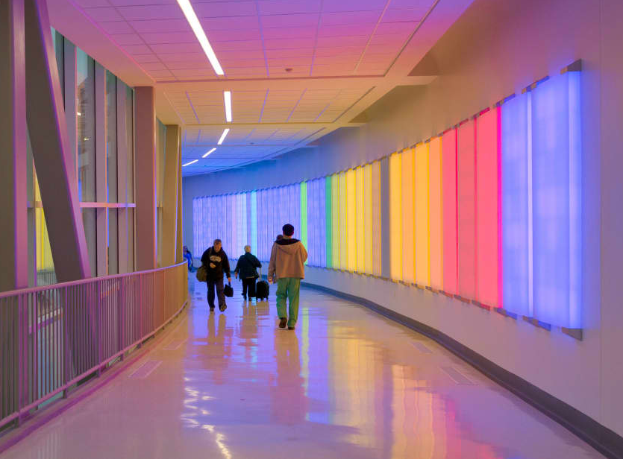
Public Art
Ansen Seale, You Activate This Space, completed 2014
An interactive environment for the employees of University Health System

Slide 10
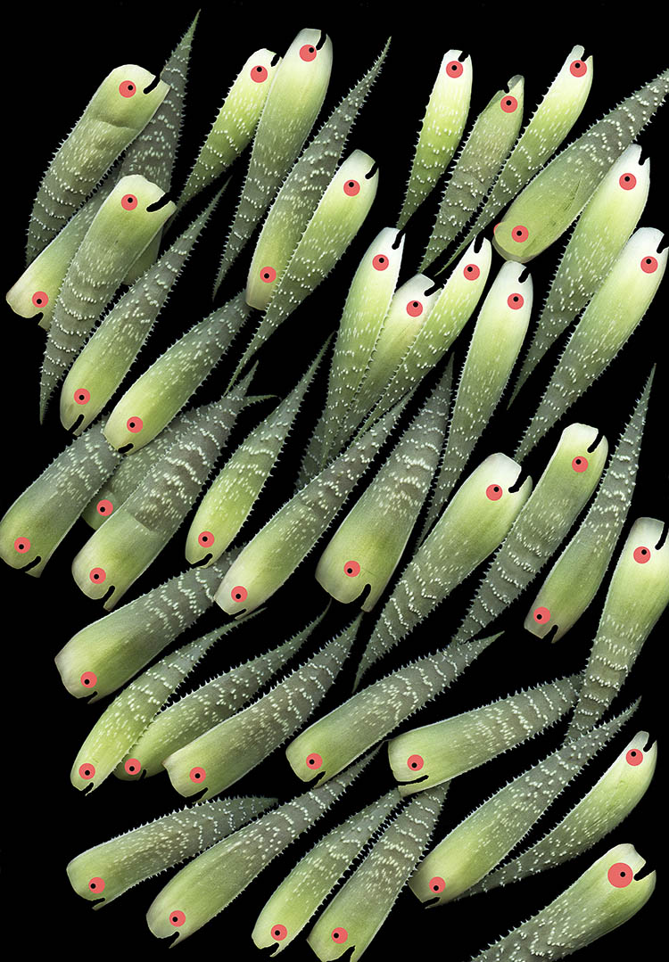
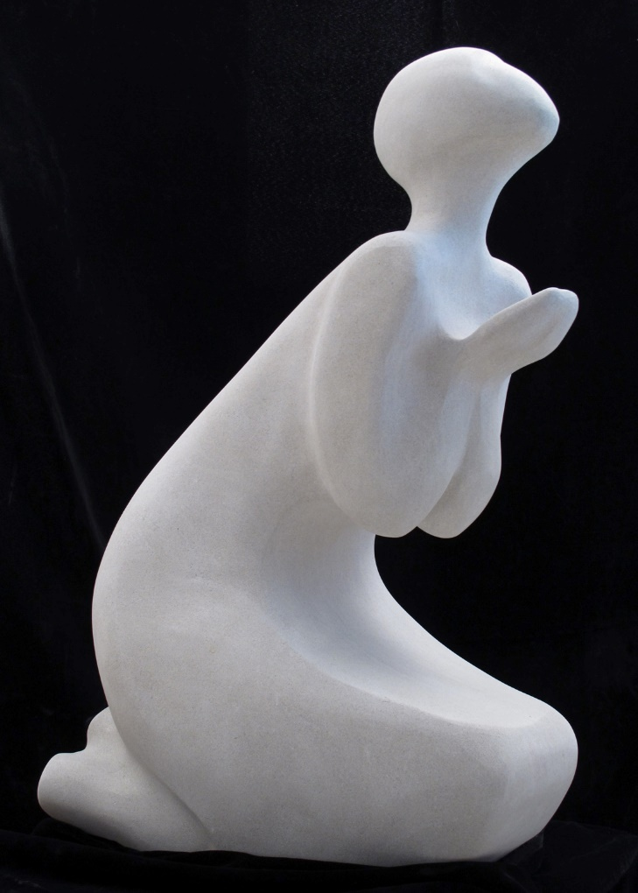
Art Procurement
Doug McLarty, Aloe Bait Ball
Trish Simonite, Green Aloe
Ruth Burink, Waiting for Rain

Slide 11
Phase I: Calls A & B for Design Enhancement November 15th, 2020-March 1st, 2021
www.publicartist.org
-CALL WCH DE1-A: Design Enhancement, patient room and corridors, Floors G-12
Opportunity for Solo, Mentor| Apprentice teams, each artist will design (2) floors
-CALL WCH DE 1-B: Design Enhancement, Elevator Lobbies, Floors G-12, artist or artist team will design (12) areas on each floor and integrate wayfinding and donor signage. Experienced artist required, not a mentor opportunity.
Artist applying will receive:
Detailed elevations and description of art work locations
Instructions on how to register as a UHS vendor
Description of what the scope and expectations will be working with us and our Architect team, Marmon Mok, San Antonio and ZGF, Los Angeles.
Artists will be reviewed by our UHS Art Committee and notified in mid- March if selected

Slide 12
Phase I: Call C for Design Enhancement
www.publicartist.org
Call WCH DE1- C, Design Enhancement of main lobby architectural glass signature wall with design for exterior and interior. Exterior to be enhanced with a pattern or design and interior to hold the names of 20,000 donors to the new Women’s & Children’s Hospital.
Artist must have experience and this is not an opportunity for a mentor and apprentice team
Opens November 15th and closes January, 17th 11 PM CST
Please note accelerated close date

Slide 13
Vendor Registration Support
Contact information: edward.cruzjr@uhs-sa.com or 210.743.6402
Call me lets talk!
NAICS Code: 711510,711410, 541430
Artist can seek certification, services are free and performed by the local certification agency SCTRCA paid for by UHS for the benefit of the small business community
South Central Texas Regional Certification Agency link: https://sctrca.org/smwvbes-certifications/
The application process is completely on line no social interaction required, no carbon footprint and all documentation is electronic
Businesses can seek Small Business Enterprise certifications at a minimum based on SBA size standards
Business owners may also seek to have their business identified as a AABE, HABE, NABE, MBE, WBE or VBE

Slide 14
Upcoming Calls: Salud-Arte: Art of Healing
Phase II: Public Art Site Specific
Public presentations will begin in January- March 2021
Calls open for Phase II, March 1 – June 1, 2021
Selection and finalists will be notified, mid-late June, 2021
Phase II: Art Procurement
Public presentations will begin, Fall 2021
Calls open for Phase II, November 15, 2021- June 1, 2022
All updates subject to change: Check www.publicartist.org

Slide 15
Questions?
Please email general questions to:
Allison Hays Lane, Curator & Archivist
Planning, Design & Construction | Corporate Communications
Raquel Belden, Administrative Assistant
Allison.Lane@uhs-sa.com
Raquel.Belden@uhs-sa.com
Submission questions: www.publicartist.org
THANK YOU for your support!

